Slide 1

Cryptocurrency Analysis A project by the May 2021 Group D team of Diploma in Data Analytics Toronto School of Management Ontario Canada. Submitted to Jaydeep Chakraborty
On June 14, 2021
In completion of the Data Design Module using Microsoft Excel and Microsoft PowerBI

Slide 2

introduction

Slide 3
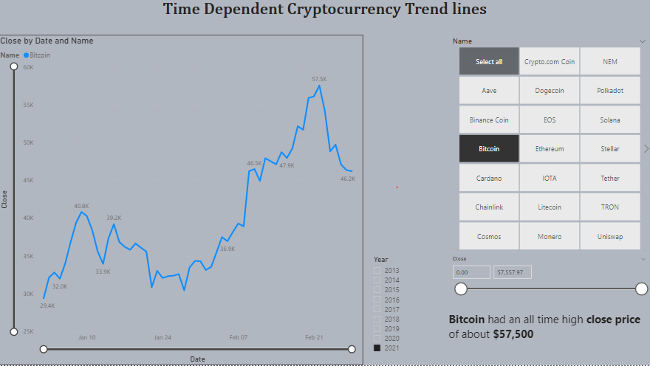

Slide 4
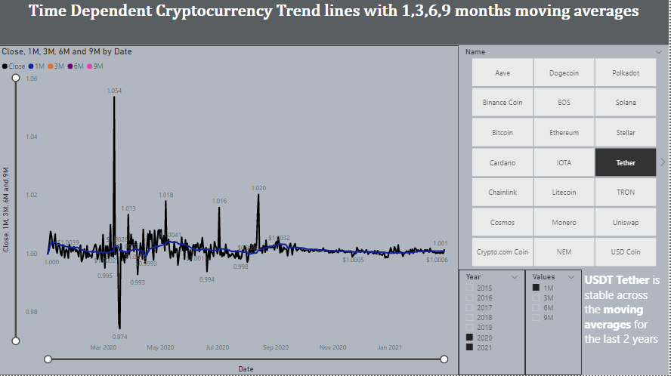

Slide 5
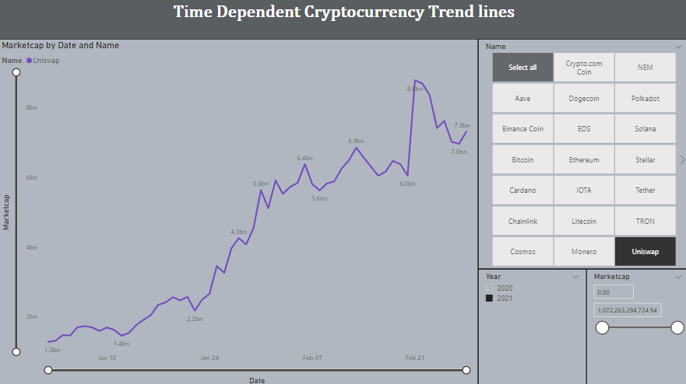

Slide 6
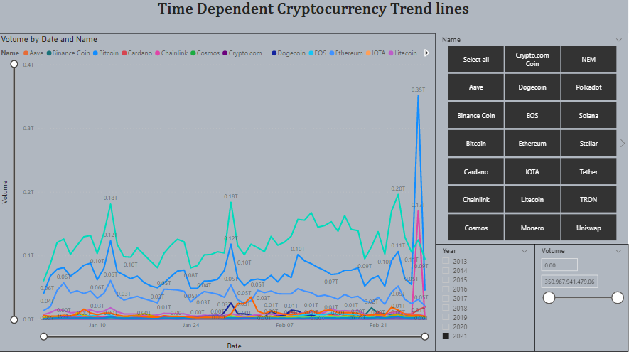

Slide 7
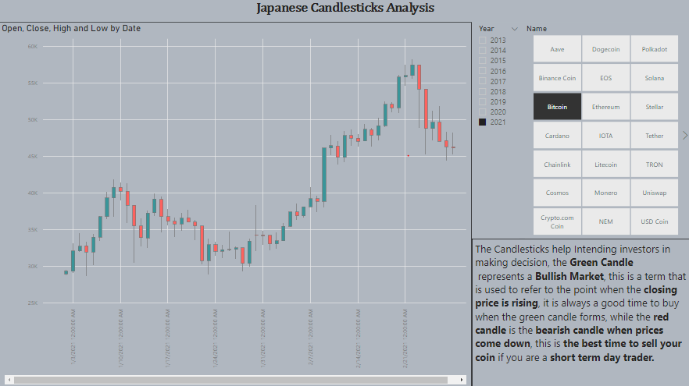

Slide 8
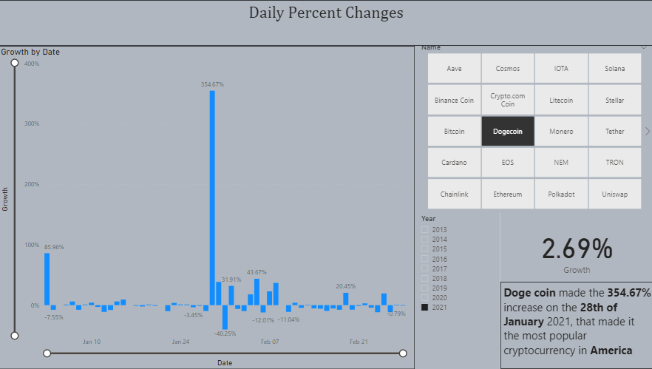

Slide 9
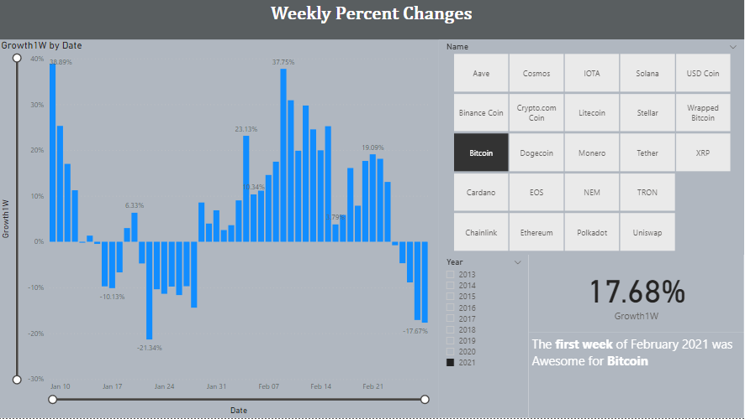

Slide 10
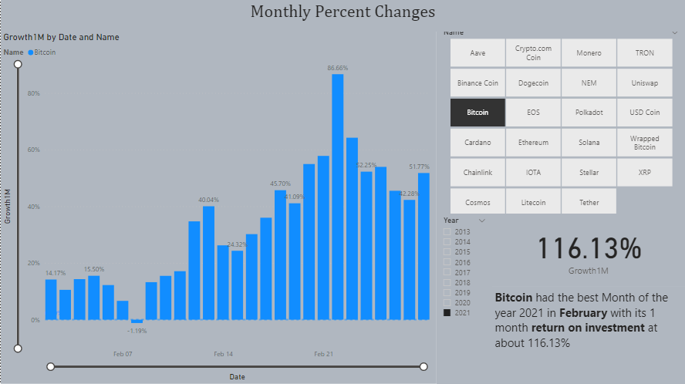

Slide 11
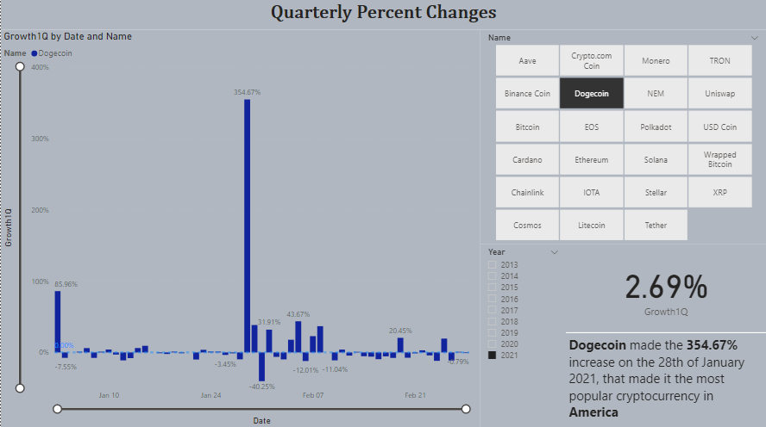

Slide 12
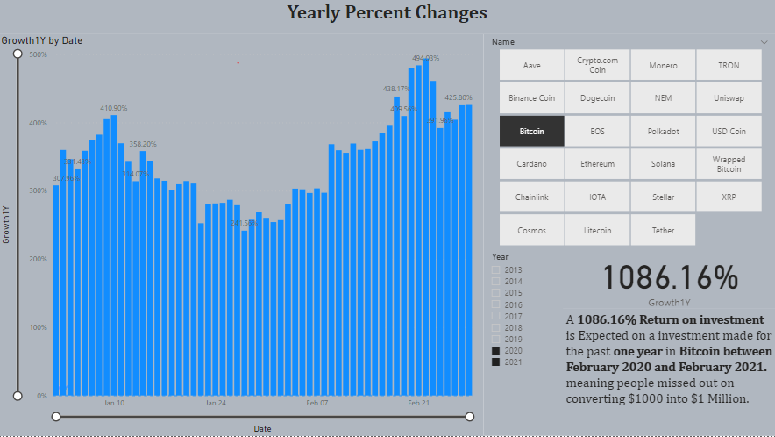

Slide 13
